Slide 1


PRESENTS
SMART
FARM PRODUCTIVITY SYSTEM(SFPS)
FOR
KERCHANSHE TRADING PLC

Slide 2

HIGH LEVEL OBJECTIVES
The SFPS will be the primary tool for Kerchanshe to disseminate best agricultural practices and to record details of important information.
The SFPS will allow instant reporting on assessment and technical advices.
“
The project is focused on building a Digital solution to facilitate the recording, reporting, analysing, prioritizing and monitoring of the Farm activities
“
Notes:
Project Outcomes (10,000 feet overview)
a. Enhance customer experience
b. Processes Automation
c. Provide ADAFSA internal users with one Product to manage day to-day business operations
d. Minimize the number of human interventions …. and in the process
e. Build a comprehensive database of farms and farmers
f. Provide ADAFSA management with Dashboards, and reports on the whole aspects of the
services.
High-level Objectives
1. Provide better technical advisory services during farm visits
2. Help farmers to adopt recommended practices and innovations
3. Evaluate and monitor programs and extension staff so that better management decisions can be made to increase farm production & sustainability
4. Provide extension staff with a unified vision that enables greater productivity in the farms while preserving natural resources and promoting sustainability of resources
5. Finally…the Assessment and measurement of agricultural sustainability index (44 key indicators)

Slide 3

PROJECT SCOPE
01
TO CREATE AGRICULTURAL PRODUCT
DATABASE TO MANAGE SFPS DATA
....................................................................
01
INTELLIGENT SYSTEM FOR CAPTURING DATA, MAINTAINING DATA INTEGRITY AND FOR PREVENTING DUPLICATION
.........................................................
02
RESPONSIVE WEB, MOBILE AND TABLET APPLICATION FOR MANAGING THE
FARM ACTIVITIES
.............................................
03
INTUITIVE DASHBOARD, COMPREHENSIVE REPORTS AND WORKFLOW MANAGEMENT
...................................
04
Notes:
Project Scope
2. Capture farm visit records using mobile devices that are geo enabled
3. Mobile app with intelligent and intuitive workflows to capture data

Slide 4
02
OFFLINE FORMS SAVING AND ONLINE SYNC CAPABILITIES
...................................
05
GEO ENABLED SERVICES
.............................................
06
INTEGRATION WITH OTHER PARTNER SYSTEMS
.........................................................
07
WEB APP DEV USING ASP.NET, MS SQL &.
MOBILE DEV USING REACT NATIVE
....................................................................
08
Notes:
5. integration with Siebel to manage, farms, farm owners etc.
6. Ensure data security and integrity
7. Web based Reports and Analytics dashboard for management
8. Advice on technology and frameworks that enable scalability and meet diverse integration requirements

Slide 5
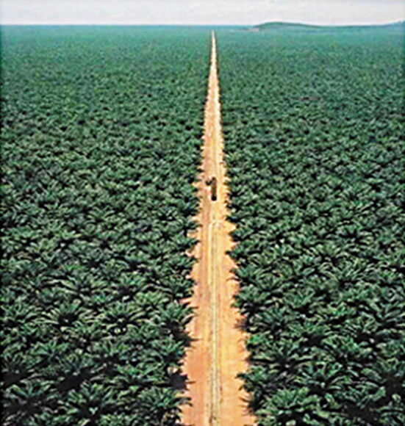
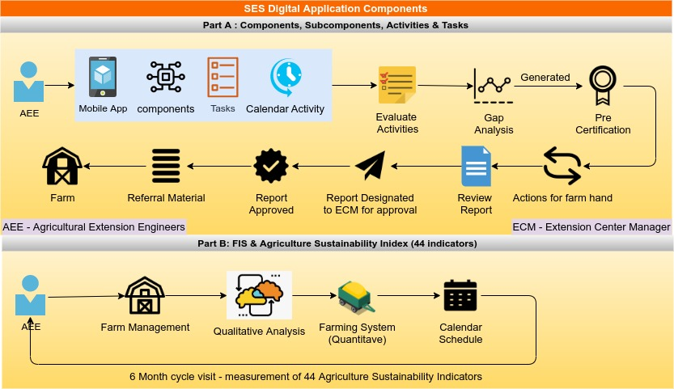
SMART FARM PRODUCTIVITY SYSTEM
FUNCTIONAL REQUIREMENTS
Notes:
Change AEE to – Farm Support Engineer (FSE)
Smart Farm Productivity System Components – SFPS
Report Designated to Center Manager for Approval – CM
Part B- FDS(Farm Data System ) and Agriculture Holding Index (44 Indicators)

Slide 6
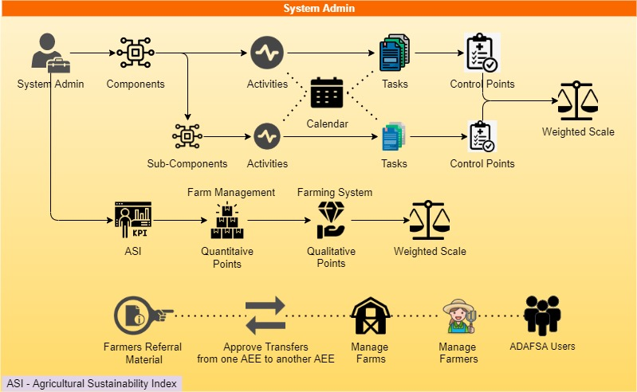
ADMIN USER
FUNCTIONAL REQUIREMENTS
Notes:
Approve Transfers from one FSE to another FSE
Kerchanshe Users
AHI – Agriculture Holding Index
What is ASI in the above diagram?? Please discuss with me while you are editing so that I will advise on the replacement

Slide 7
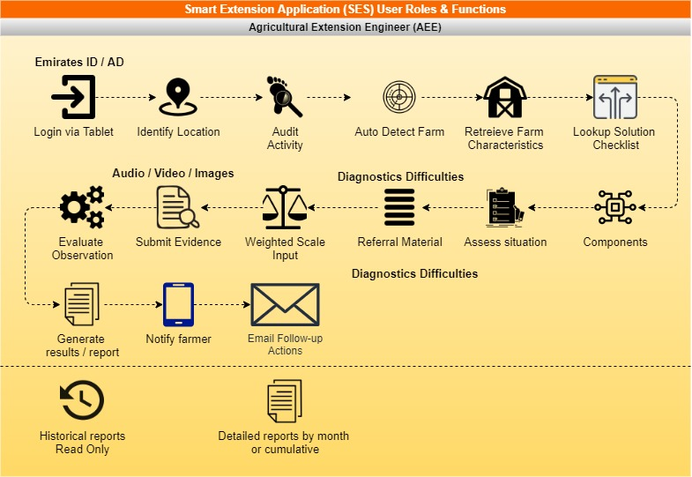
FARM SUPPORT ENGINEER (FSE)
FUNCTIONAL REQUIREMENTS
Notes:
Smart Farm Productivity System Components – SFPS
Change AEE to – Farm Support Engineer (FSE)
Remove Emirates – Write Just “ID”

Slide 8
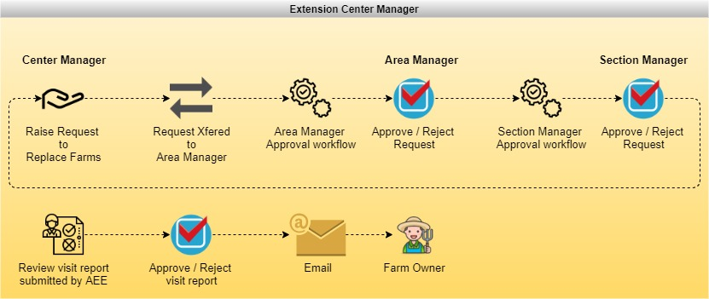
CENTER MANAGER
FUNCTIONAL REQUIREMENTS
Notes:
Change Extension Center Manager to “Center Manager”- CM
Change AEE to – Farm Support Engineer (FSE)

Slide 9
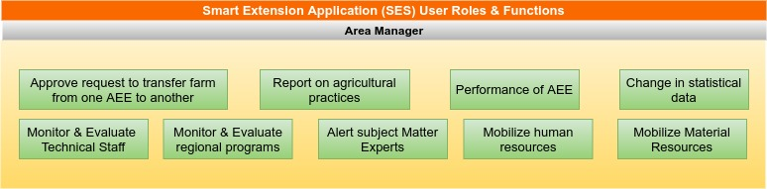
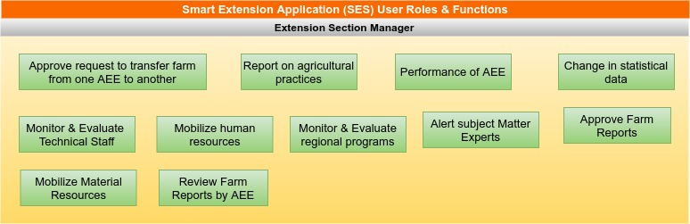
AREA MANAGER AND SECTION MANAGER
FUNCTIONAL REQUIREMENTS
Notes:
Change AEE to – Farm Support Engineer (FSE)
Smart Farm Productivity System Components – SFPS
Replace Extension Section Manager with just “Section Manager”
Replace Subject Matter Specialists with– Field Experts

Slide 10
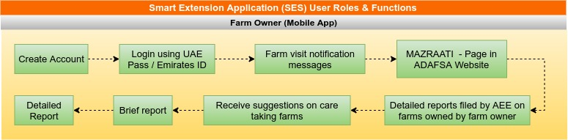
FARM OWNERS
FUNCTIONAL REQUIREMENTS
Notes:
Change AEE to – Farm Support Engineer (FSE)
Smart Farm Productivity System Components – SFPS
Login Using ID
Page Link in Kerchanshe Website

Slide 11
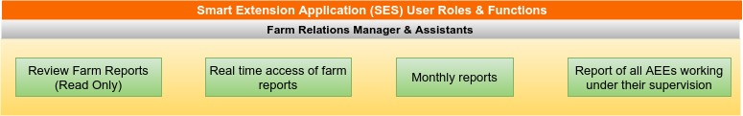
FARM RELATIONS MANAGER AND ASSISTANTS
FUNCTIONAL REQUIREMENTS
Notes:
Change AEE to – Farm Support Engineer (FSE)
Smart Farm Productivity System Components – SFPS

Slide 12
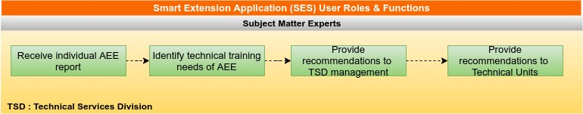
FIELD EXPERTS
FUNCTIONAL REQUIREMENTS
Notes:
Change AEE to – Farm Support Engineer (FSE)
Smart Farm Productivity System Components – SFPS
Replace Subject Matter Specialists with– Field Experts
Remove TSD – Retain Just MANAGEMENT

Slide 13
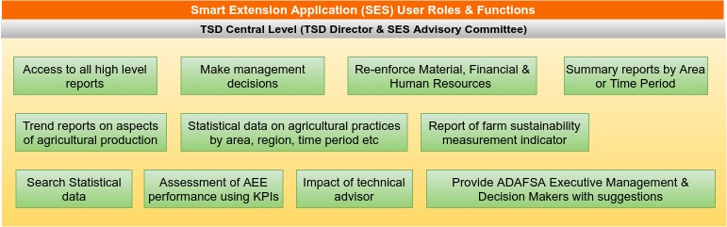
TSD CENTRAL LEVEL
FUNCTIONAL REQUIREMENTS
Notes:
Remove TSD Director and SES Advisory Committee
Smart Farm Productivity System Components – SFPS
Change AEE to – Farm Support Engineer (FSE)
Remove ADAFSA and replace with Kerchanshe

Slide 14

01
ENHANCED USER EXPERIENCE BY AUTOMATING PROCESSES AND BY REDUCING HUMAN INTERVENTIONS
01
ASSESSMENT OF TECHNICAL DATA, FARM INFORMATION SYSTEM (FIS) & AGRICULTURE SUSTAINABILITY INDEX (44 INDICATORS)
02
APPLICATION
FEATURES.
03
USER FRIENDLY DASHBOARDS, REPORTS AND WORKFLOWS
04
CONTINUOUS FEEDBACK AND PERFORMANCE MONITORING

Slide 15
02
05
DATA ANALYSIS USING SES OUTPUTS
06
IN APP NOTIFICATION AND MESSAGING FEATURES
07
DESIGN & DEVELOPMENT USING THE MOST MODERN PRACTICES.
08
MULTILINGUAL SYSTEM
ENGLISH & ARABIC

Slide 16
PROJECT MANAGEMENT METHODOLOGY
Requirement Gathering
Verbat works with various stakeholders to identify User requirements.
Coding
Error free executable programs are created using the designs developed in previous steps
1
5
Feasibility Study Through POC’s Verbat will verify if it can meet the client requirements
Testing Implemented in all phases from req. gathering to coding. Over 50% of effort is used in testing.
2
6
System Analysis The team will analyze the project to determine Scope, Limitations, Resources and Schedules
Implementation Software is tested for portability and adaptability and integration issues are solved.
3
7
Software Design The requirements are translated to logical & physical designs accompanied by pseudocode
Operation and Maintenance Users are trained with sufficient documentation to operate the software correctly
4
8

Slide 17
HIGH LEVEL PROJECT PLAN
Initiation
Prototype, & Documentations
Prototype/UI/UX Approval
Development & QA
DB Design
Coding
Testing
QA
Deployment & Maintenance
UAT
Sign-off
Warranty /Support
Administrative tasks (Contract, Advance payment)
Project Kick-off
Other Documentation Deliverables
BRD/SRS creation and approval
Prototype/UI/UX Initiation
On Project Approval
96 days from Prototype/UI/UX Approval
After 20 days
After 14 Days Development

Slide 18

PROJECT MANAGER
PROJECT
TEAM
BUSINESS ANALYST TEAM
PROJECT COORDINATION TEAM
DELIVERY MANAGER
DESIGN TEAM
DEV TEAM
QA TEAM
TECH WRITER

Slide 19


ARCHITECTURE
DIAGRAMS

Slide 20
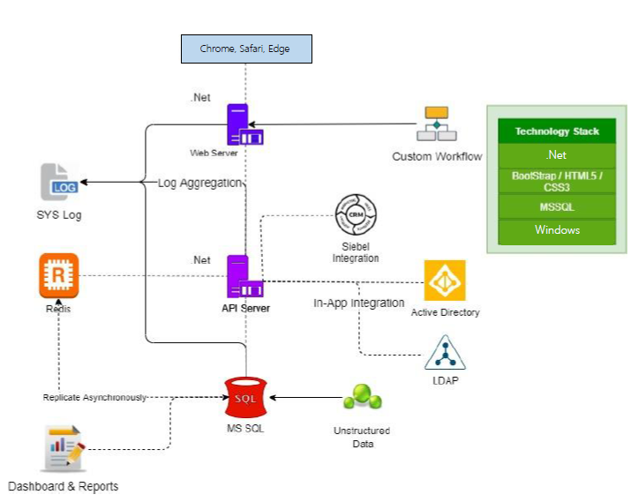
MINIMUM VIABLE ARCHITECTURE
Notes:
Remove Siebel with CRM

Slide 21
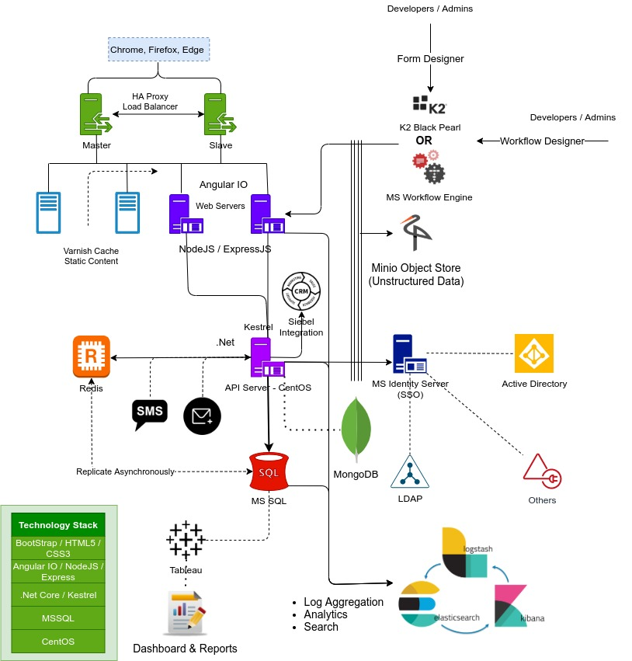
SCALABLE ARCHITECTURE
Notes:
Remove Siebel with CRM

Slide 22
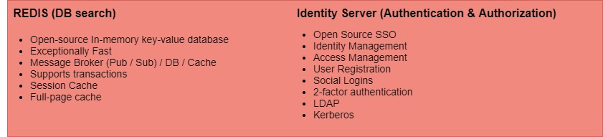
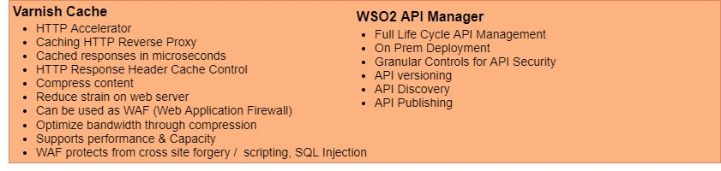
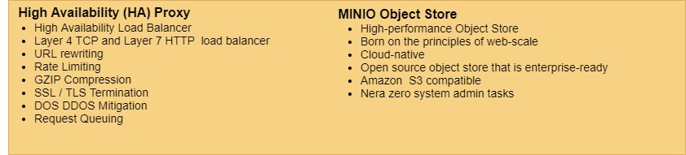
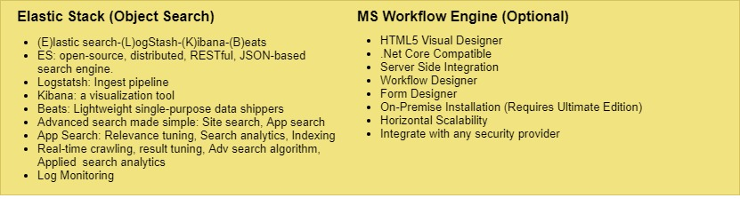
ARCHITECTURE
RATIONALE
Notes:
Detailed software and hardware requirements of the proposed solution and its scalability.
Solutions adaptability/configurability to the changing business requirements.

Slide 23
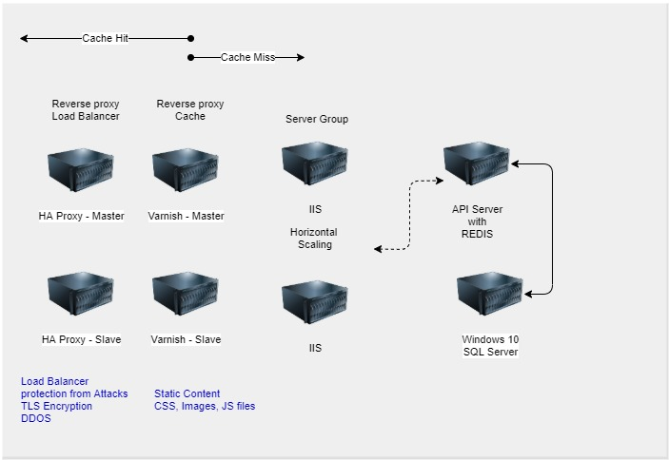
NETWORK
TOPOLOGY
Notes:
Detailed software and hardware requirements of the proposed solution and its scalability.
Solutions adaptability/configurability to the changing business requirements.

Slide 24
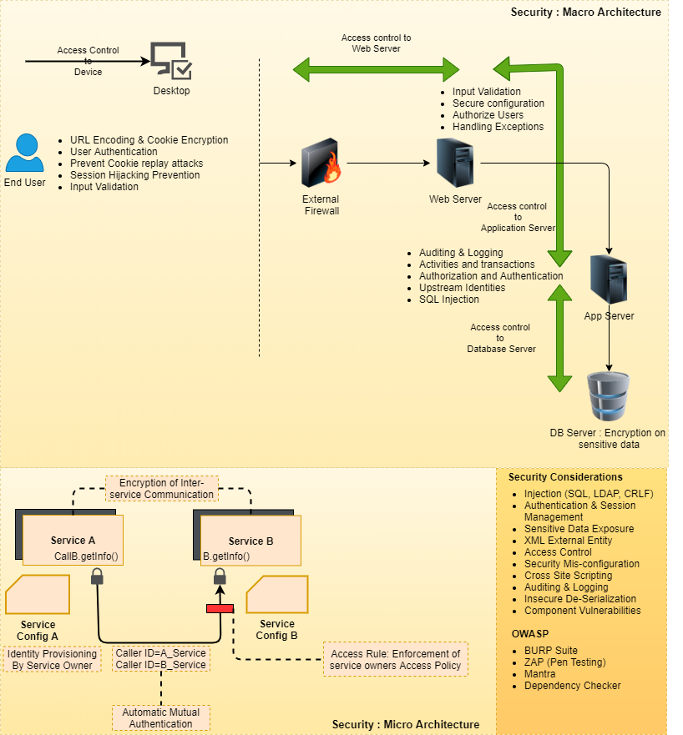
SECURITY
FRAMEWORK
Notes:
Detailed software and hardware requirements of the proposed solution and its scalability.
Solutions adaptability/configurability to the changing business requirements.

Slide 25
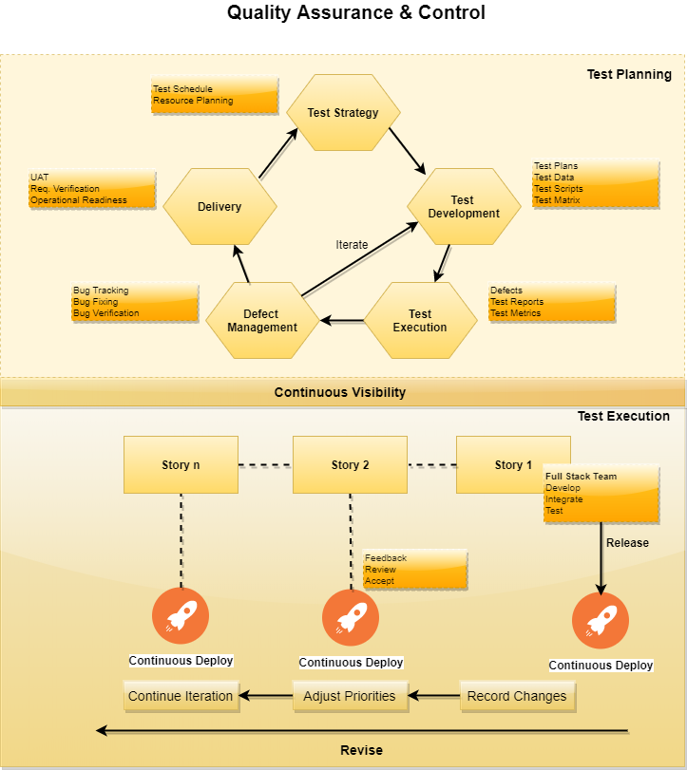
QUALITY
ASSURANCE
Notes:
Detailed software and hardware requirements of the proposed solution and its scalability.
Solutions adaptability/configurability to the changing business requirements.

Slide 26
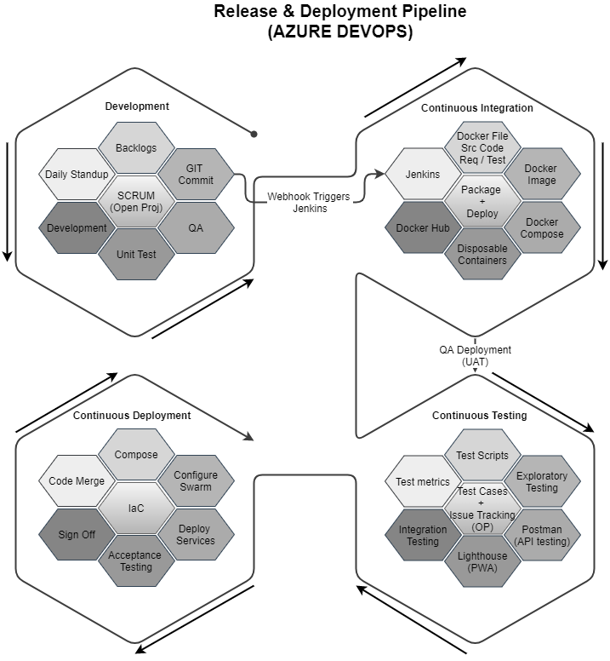
RELEASE &
DEPLOYMENT PROCESS
Notes:
Detailed software and hardware requirements of the proposed solution and its scalability.
Solutions adaptability/configurability to the changing business requirements.

Slide 27





Globally Accredited Software Consultation Partner
IT Strategy, Application Development, Maintenance and Testing Services, Information Management, Digital Marketing
WHY VERBAT
Nearly two decades of development experience to Global Corporates and Government
Verbat is a Digital Technology Services company with 20+ years of experience in delivering Internet and Mobile Solutions to Enterprises, through Agile Development and Application Management Methodologies.
Domain specialists in Banking, Retail, Logistics, Construction, Fashion, Manufacturing, Hospitality, Automotive, Government & Healthcare
Spearheaded by a team of Technology and Management Leaders

Slide 28

[
[
Q A
&

Slide 29




At Verbat, we are committed to make IT services a pleasant experience. As such we always welcome your enquires, feedback and suggestions
Let’s Hear From You
Get in Touch
217, Sheikh Rashid Building PO Box 56272, Dubai
+971 4 2973236
USA 600 Eagle View Blvd, Suite 300
Exton Pa 19341
INDIA Level III, PTC Tower, Nanthancode, Trivandrum, Kerala
Luay.houri@verbat.com

Slide 30
A VERBAT
THANK YOU
PRESENTATION

Slide 31
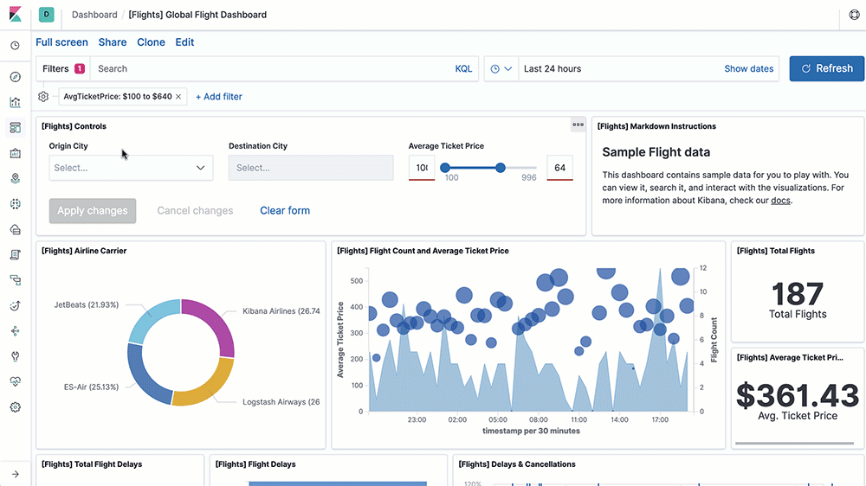

Slide 32
